Slide 1
STACK-BASED ISA
CSC-201: Computer Architecture and Organization
End Term Project
Team Members:
Jai Bhadu
Nitin Raj
Madhav Deorah
Hemani Konkati
Samrat Middha

Slide 2
WHAT IS A STACK BASED INSTRUCTION SET?

Slide 3
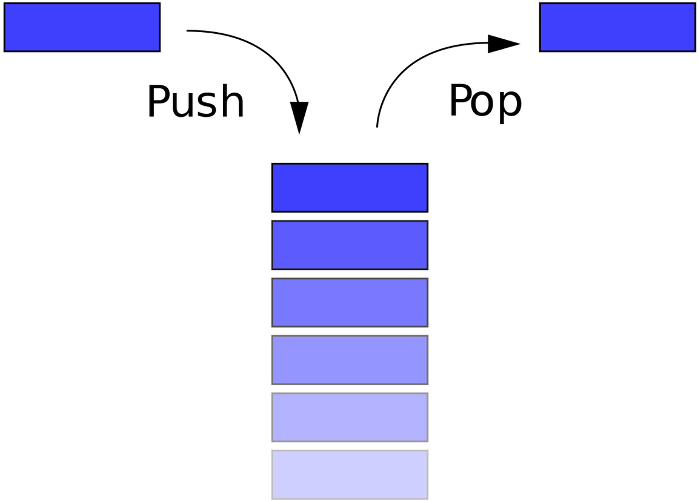
LIFO STACK FOR COMPUTATION
Stack based ISAs use Last in First out stack for computation , where operands are defined as elements on top of the stack

Slide 4
HOW IS STACK BASED ISA DIFFERENT FROM CONVENTIONAL ISA?
01
02
NO EXPLICIT OPERANT REGISTERS
SIMPLER TO IMPLEMENT
Can be less efficient in some areas
Operands are taken from TOS
03
04
SMALLER PROGRAM SIZE
VERSATILE FOR HARDWARE
implicit operands insure small size
Easy to implement on a wide variety of hardware

Slide 5
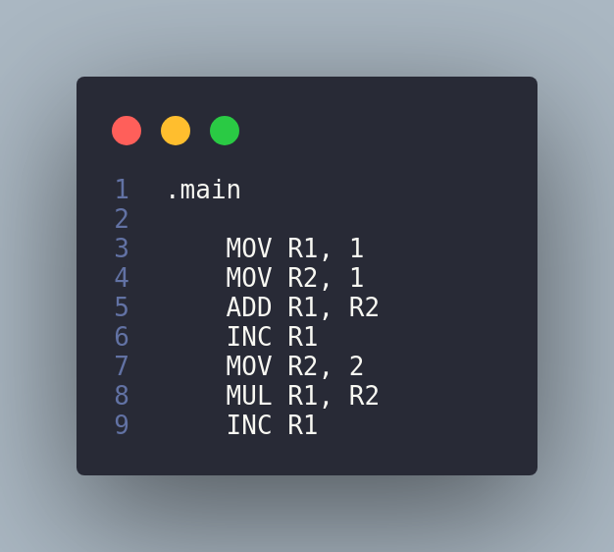
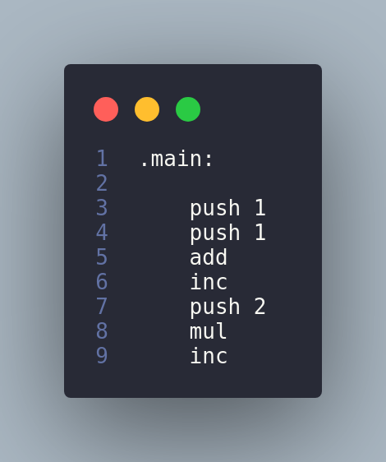

REGISTER ISA VS STACK BASED ISA
SIMPLER AND MORE COMPACT INSTRUCTIONS

Slide 6
"Although virtually every processor today uses a loadstore register architecture, stack architectures attract attention again due to the success of Java.."
MARTIN SCHOEBERL

Slide 7
OUR APPROACH TO A STACK BASED INSTRUCTION SET ARCHITECTURE
1: CUSTOM ISA
Custom ISA with a variety of instructions including branch instructions implemented in C++.
2: MULTIPLE STACKS
Contains DataStack , Return Stack , ALU, IO/Control module and a Program Memory.
3: VISUALISATION/DEBUGGER
Visualisation of Stacks and memory in real time Using SDL (Simple DirectMedia Layer).

Slide 8
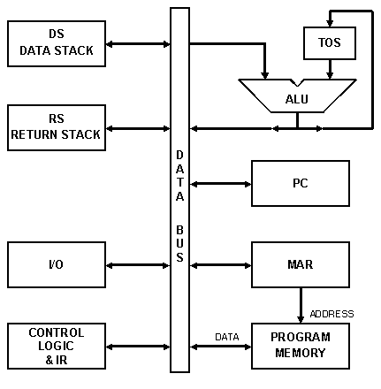
HOW ARE INSTRUCTIONS EXECUTED
Instructions are retrieved from the program memory by the PC
Now, instead of registers the ALU manipulates the TOS
The operands are fetched from TOS and Result is saved in TOS
The Return Stack stores the Return Addresses for call instructions

Slide 9
INSTRUCTION SET
ARITHMETIC AND LOGICAL
STACK
MANIPULATION
CONTROL AND
BRANCH
add
sub
mul
div
inc
dec
mod
and
or
xor
push <op>
pop
pushr <op>
popr
dup
swap
over
drop
cmp
b
beq
bgt
call
ret
halt

Slide 10
LIMITS OF A STACK BASED ISA
HOW TO USE LOOPS ?
HOW TO USE RECURSION?
HOW TO WRITE COMPLEX APPLICATIONS?

Slide 11
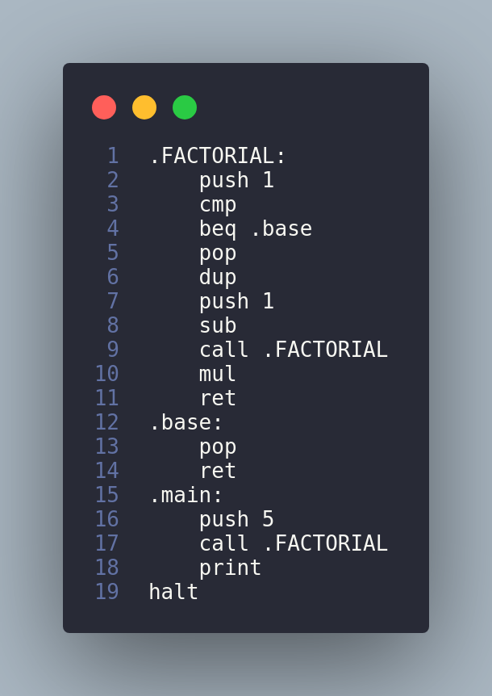
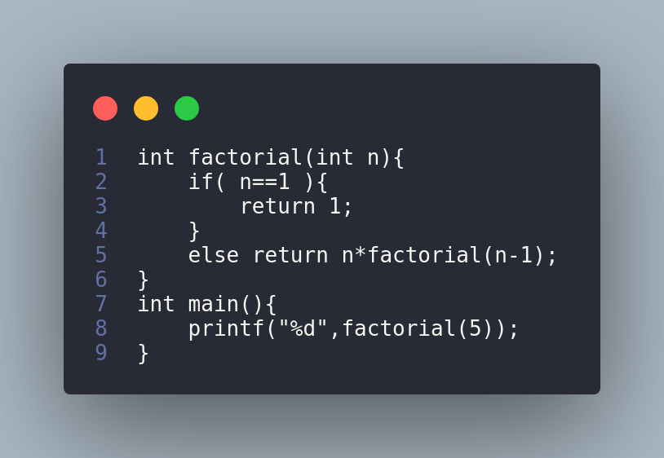
FACTORIAL USING RECURSION

Slide 12
DISADVANTAGES
Difficult to implement even simple loops and recursive functions
Implementations are very inefficient
You Lose Readability and Efficiency

Slide 13
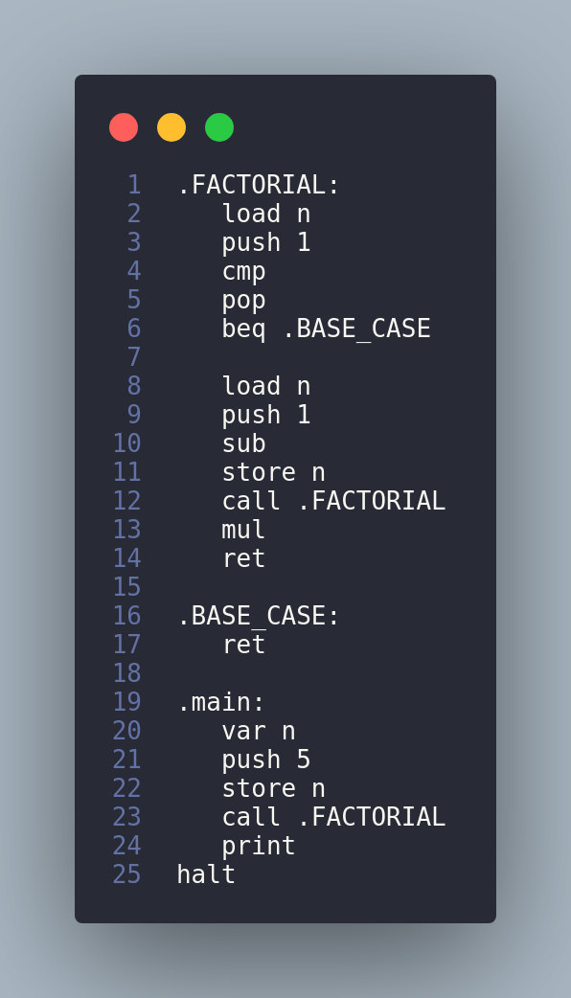
ONE SOLUTION:
Use Variables
VARIABLES
Var <var>
store <var>
load <var>

Slide 14
Variables need to be accessed from memory every time.
Still doesn’t address the issue of efficiency.
Use of Variables requires either complex pattern of dup , push , pop or explicit store/load instruction

Slide 15
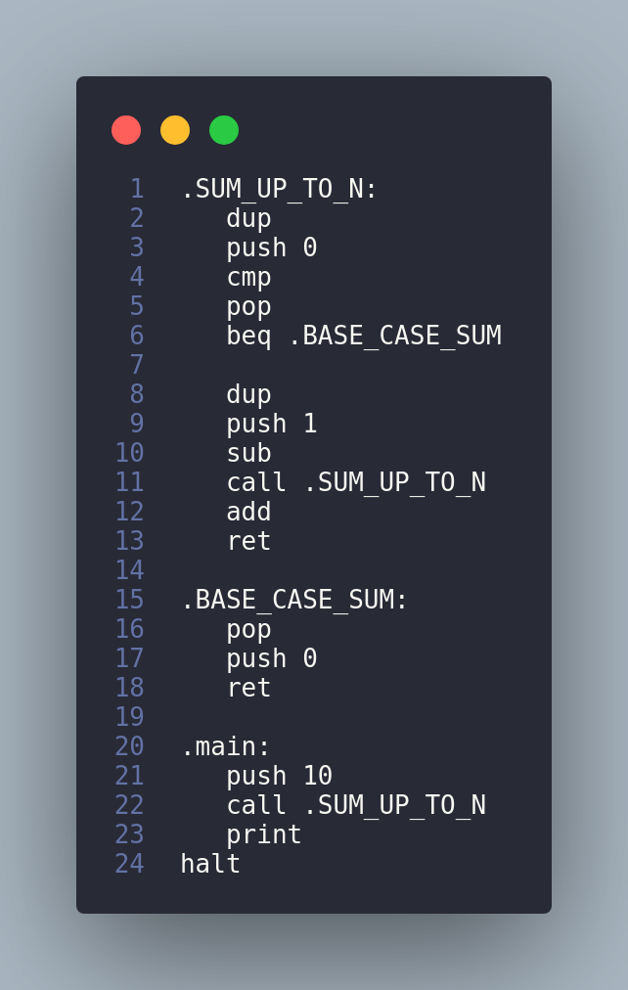
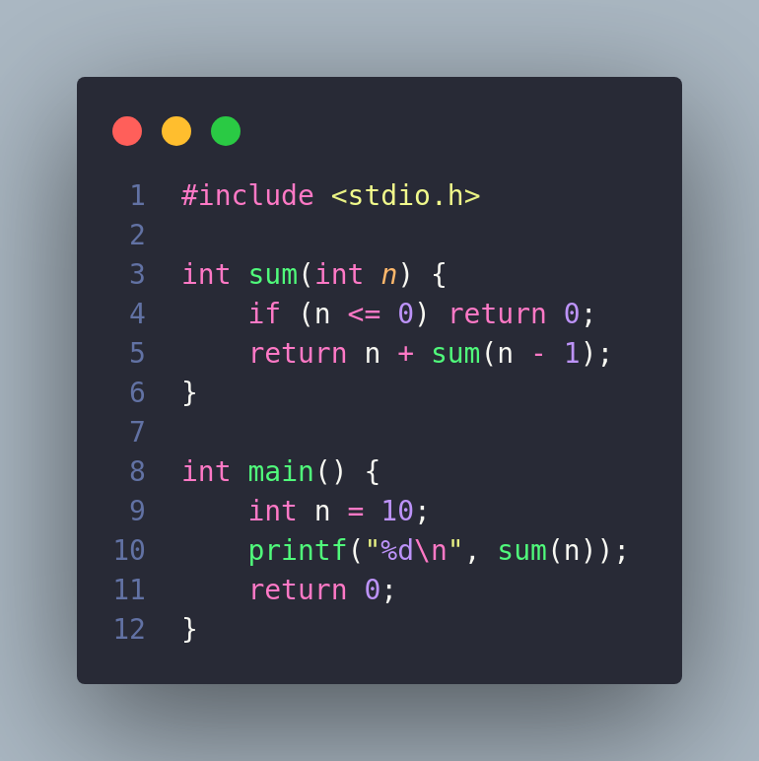
EXAMPLE PROGRAMS

Slide 16
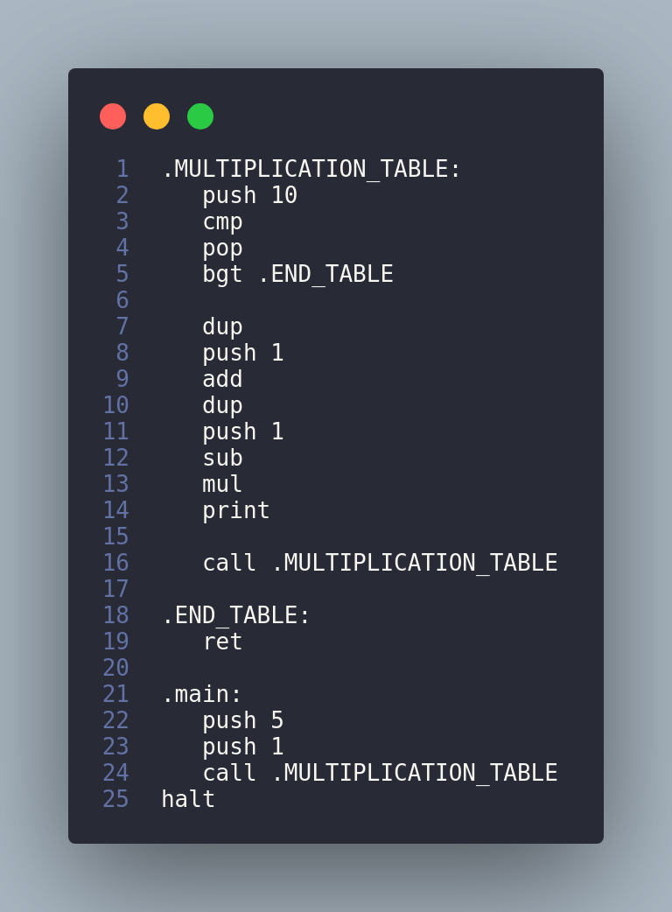
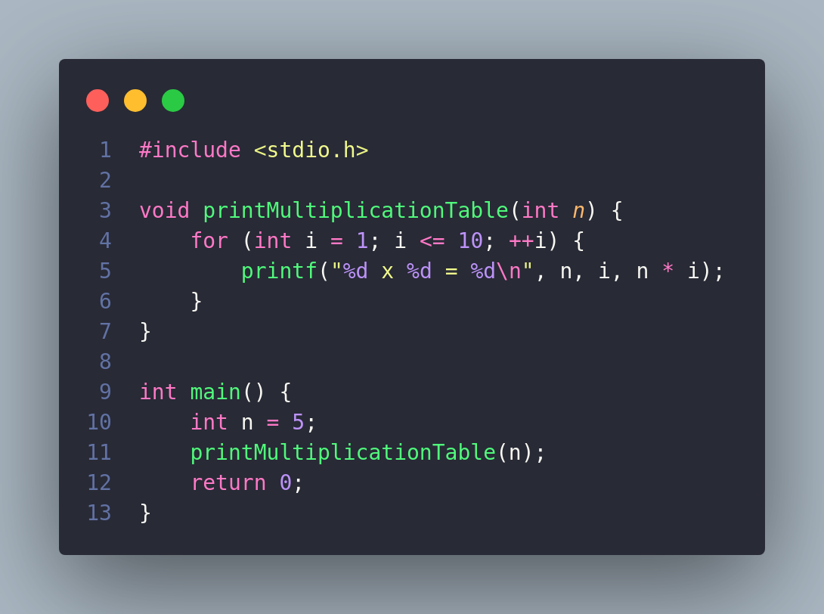
EXAMPLE PROGRAMS

Slide 17
VISUALISATION
View of Memory , Data Stack , Return Stack and PC after each instruction
View Execution and go back or go forward at each step
Implemented in SDL2
Useful for visualising and debugging code

Slide 18
